Slide 1
Degree Part II(Honours Course)
Paper-III
Indian Government and Politics
Gangesh Kumar Jha
Assistant Prof.,
Department of Political Science
Marwari College
Darbhanga

Slide 2
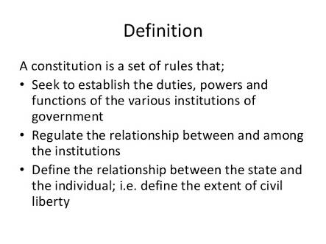

Slide 3


Why Do We Need Constitution?
In General-
We need a constitution to govern a country properly.
The constitution defines the nature of political system of a country.
sometimes we feel strongly about an issue that might go against our larger interests and the constitution helps us guard against this.
All the 3 organs of government (executive, legislature and judiciary) functions within the constitution. All the 3 organs of government, including ordinary citizens, derive their power and authority (i.e. Fundamental Right) from the constitution. If they act against it, it is unconstitutional and unlawful.
So constitution is required to have authoritative allocation of power and function, and also to restrict them within its limit.

Slide 4
Why Do We Need Constitution?
To perform following Functions we need Constitution-
The first function of a constitution is to provide a set of basic rules that allow for minimal coordination amongst members of a society.
The second function of a constitution is to specify who has the power to make decisions in a society. It decides how the government will be constituted.
The third function of a constitution is to set some limits on what a government can impose on its citizens. These limits are fundamental in the sense that government may ever trespass them.
The fourth function of a constitution is to enable the government to fulfill the separations of a society and create conditions for a just society.

Slide 5
What Is Constitution Anyway?
Role of Constitution in relationship between Government and its people:-
CONSTITUTION
GOVERNMENT
THE PEOPLE
LEGISLATIVE
Makes Laws
JUDICIARY
Interprets Laws
EXECUTIVE
Enforces Laws
Fig.- Role of Constitution in relationship between Government and its people

Slide 6
Framing of the Constitution of India
Following slides help you understand the process of formation of the Constituent Assembly of India, which, by no means, an accident rather the incessant struggle and people unflinching faith in their leaders paved the way for the freedom of this nation, the beginning is the Formation of the Constituent Assembly for India. Details of the debates can be accessed from Parliament of India website.

Slide 7
History of the Constitution of India.
Indian Councils Act (1861)- A separate legislative council was set up to assist the Governor-General in making laws. Indians could be appointed to the council, but only on the discretion of the Governor-General.
Indian Councils Act (1892)- As a result of Indian demands, the sizes of the executive and legislative councils were increased. More Indians were appointed to these Councils, and the principle of election was introduced.
Indian Councils Act (1909)- This act increased the sizes of the councils again, and also gave the legislative council the power to discuss certain matters and to ask questions. More people were elected to the councils.
Government of India Act (1919)- This introduced 'diarchy' (partial responsible government) at the provincial level. Elected Indians were given charge of some areas of government (e.g., industry, education) at the provincial level.

Slide 8
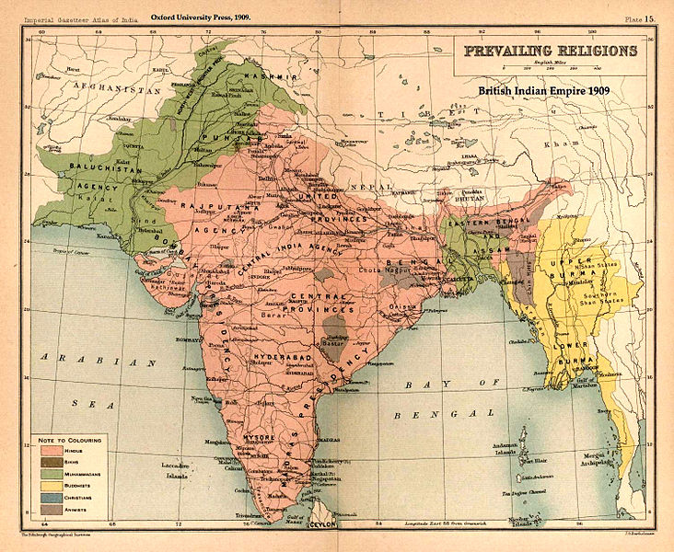
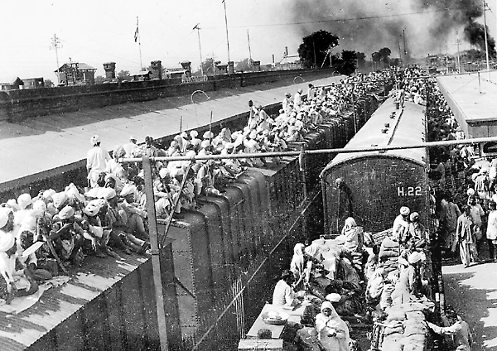
History of Constitution of India.
Government of India Act (1935)- This introduced 'provincial autonomy': responsible government at the provinces with elected Indians in charge of the administration, and responsible to the elected legislatures. A federal government was proposed, though it did not come into effect. At the centre, 'diarchy' was introduced.
Indian Independence Act (1947)- The British gave up control of the Government of India to two dominions - India and Pakistan. For the time being till the constitution was made, both of them would be governed in accordance with the Government of India act 1935.
The Partition of British India was based on the prevailing religions,
broadly as shown in this map of 1909.
Photo of Refugees at railway station in Punjab

Slide 9
History of Constitution of India.
5) Constitution of India(1950AD)- The Constitution was enacted by the Constituent Assembly on 26 November 1949, and came into effect on 26 January 1950.
The date 26 January was chosen to commemorate the Purna Swaraj declaration of independence of 1930. With its adoption, the Union of India officially became the modern and contemporary Republic of India and it replaced the Government of India Act 1935 as the country's fundamental governing document.
Conscious efforts were made to have consensus on different issues and principles and thereby avoid disagreement. The consensus came in the form of the ‘Objectives Resolution’ moved by Jawahar Lal Nehru in the Constituent Assembly on December 17, 1946 which was almost unanimously adopted on January 22, 1947.

Slide 10
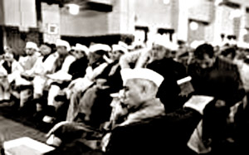
The Constituent Assembly
The British sent a group of officials known as the cabinet mission
The cabinet mission formed the constituent assembly in Dec 1946
There was a dispute among the Indian national leaders and the partition took place.
After the partition and independence the constituent assembly took up the work for framing the constitution.
There were 308 members who were elected by the Provincial Legislative Assembly.
The congress ensured that all the communities get equal recognition

Slide 11
INTRODUCTION
The Constitution of India was drafted by the Constituent Assembly. The Constituent Assembly held its first sitting on the 9th December, 1946. It reassembled on the 14th August, 1947, as the sovereign Constituent Assembly for the Dominion of India.
Constitution of India is the supreme law of India. It lays down the framework defining fundamental political principles, establishing the structure, procedures, powers and duties, of the government and spells out the fundamental rights, directive principles and duties of citizens. Passed by the Constituent Assembly on 26 November 1949, it came into effect on 26 January 1950. The date 26 January was chosen to commemorate the declaration of independence of 1930.

Slide 12
Composition of the Constituent Assembly
It is pertinent to trace the role of some of the important leaders who played very prominent role in the Assembly. Among them three names come on the top :Nehru, Patel and Prasad. It would be inaccurate to say that they only played the role rather they held important position within the Assembly and the image that cultivated. Nevertheless the role of Dr. B.R. Ambedkar and Sir B.N.Rau was immanent.

Slide 13
Prominent Leaders of the Constituent Assembly of India
  Dr. Rajendra Prasad.
  Sardar Patel
  Mualana Azad
  S.P Mookerji
  K.M Munshi
  Sir Tej Bahadur
  A.K Ayyar
  H.N Kunzru
  C.Rajagopalachari
  Sarojini Naidu
  Vijay Laxmi Pandit
  Frank Anthony- Anglo Indians
  Dr. H.C Mookerjee- Christians
  H.P Mody- Parsis

Slide 14
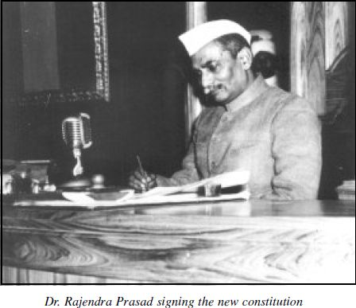
Prominent person of the Constituent Assembly
In the light of these ‘Objectives’ the Assembly completed its task by November 26, 1949. The constitution was enforced with effect from January 26, 1950. From that day India became Republic of India.

Slide 15
The Framing of Constitution of India.
The Constituent Assembly of India was elected to write the Constitution of India. Following India's independence from Great Britain, its members served as the nation's first Parliament.
This body was formed in 1946 for the purpose of making independent India's constitution. The assembly passed a resolution in 1947 January defining the objectives of the constitution:-
To set up a Union of India comprising British India and the princely states.
To set up a federal form of government with separate state and central governments.
To set up a democracy in which all power is derived from the people:
I) where all people are guaranteed justice, equality and freedom;
II) where minorities, depressed classes and the tribal's rights are protected;
To protect the integrity of India and her sovereign rights over land, sea and air.
To help India attain its rightful place in the world - and work for peace and welfare of all mankind.

Slide 16
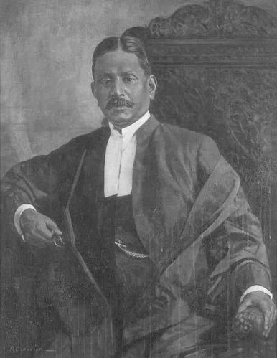
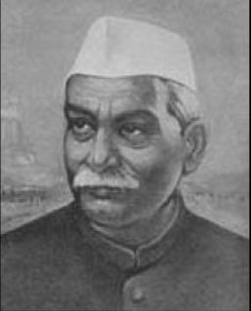
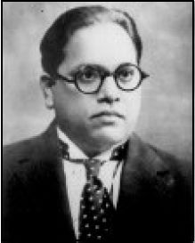
The Framing of Constitution of India.
Dr. Sachchidananda Sinha was the first president (temporary) of the Constituent Assembly when it met on December 9, 1946. Later, Dr. Rajendra Prasad became the President of the Constituent Assembly and Dr. Bhimrao Ambedkar became the Chairman of its drafting committee on December 11,1946 .
First president (temporary) Dr. Sachchidananda Sinha (Left) on December 9, 1946. Dr. Rajendra Prasad (Middle) the President of the Constituent Assembly and Dr. Bhimrao Ambedkar (Right) the Chairman of its drafting committee as on December 11,1946 .

Slide 17
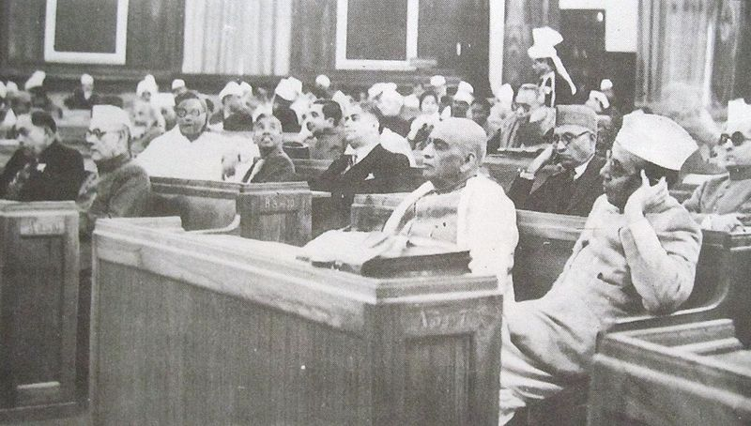
The Framing of Constitution of India.
The Constituent Assembly consisted of 385 members, of which 292 were elected by the elected members of the Provincial Legislative Assemblies while 93 members were nominated by the Princely States. To these were to be added a representative each from the four Chief Commissioners Provinces of Delhi, Ajmer- Marwar, Coorg and British Baluchistan.
First day (December 9, 1946) of the Constituent Assembly. From right: B. G. Kher and Sardar Vallabhai Patel;
K. M. Munshi is seated behind Patel.

Slide 18
The Framing of Constitution of India.
For the time being till the constitution was made, India would be governed in accordance with the Government of India act 1935.
The Assembly met in sessions open to the public, for 166 days, spread over a period of 2 years, 11 months and 18 days before adopting the Constitution.
It was finally passed and accepted on Nov 26, 1949. In all the 284 members of the Assembly signed the official copies (Original) of the Indian Constitution.
After many deliberations and some modifications over 111 plenary sessions in 114 days, the 308 members of the Assembly signed two copies (Final) of the document (one each in Hindi and English) on 24 January 1950
Same day the Assembly unanimously elected Dr, Rajendra Prasad as the President of India. which came into effect on Jan 26, 1950, known and celebrated as the Republic Day of India.

Slide 19
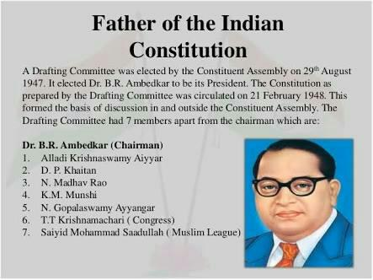

Slide 20
Public Opinion
After the draft was ready is was published in all the newspapers.
this was done to enable the people to read the draft and give their views on it.
It was discussed at great length.
The session were attended by hundreds of people and the press.

Slide 21
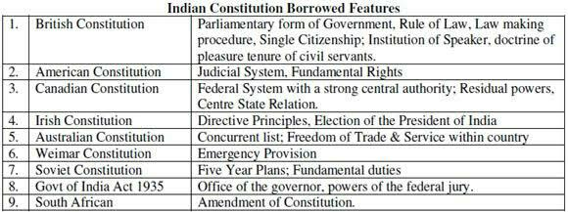

Slide 22
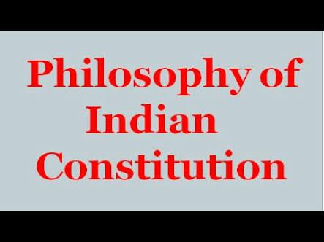

Slide 23
Philosophy of the Indian Constitution
Every constitution is guided by some philosophy and in the case of India it has to be gleaned from the Preamble, though non-justiciable in its nature, nevertheless important guiding idiom for the governance of India. Every single affirmation is a pledge we have committed for ourselves to realize and the government has to strive continuously for that.

Slide 24
The Preamble to Constitution of India.
The Preamble to the Constitution of India is a brief introductory statement that sets out the guiding purpose and principles of the document.
WE, THE PEOPLE OF INDIA, having solemnly resolved to constitute India into a SOVEREIGN SOCIALIST SECULAR DEMOCRATIC REPUBLIC and to secure to all its citizens:
JUSTICE, social, economic and political;
LIBERTY of thought, expression, belief, faith and worship;
EQUALITY of status and of opportunity;
and to promote among them all
FRATERNITY assuring the dignity of the individual and the unity and integrity of the Nation;
IN OUR CONSTITUENT ASSEMBLY this twenty-sixth day of November, 1949, do HEREBY ADOPT, ENACT AND GIVE TO OURSELVES THIS CONSTITUTION.

Slide 25
Explanation to the Preamble
The first words of the Preamble - "We, the people" - signifies that power is ultimately vested in the hands of the People of India. So far the Preamble has been amended only once in 1976 by 42nd amendment (change) which inserted the words Socialism, Secularism and Integrity. A brief description of these concepts are as follows (in the order they come in Preamble)-
Sovereign- It means free to follow internal and external Policies.
Secular- It means no particular Religion is preferred.
Socialist- It means no concentration of Power and Money.
Democratic- It means rule by elected representative of the People of India.
Republic- It means no room for hereditary ruler or monarch.

Slide 26
Sovereign ,Socialist ,Secular,Democratic, Republic
India has been declared a sovereign, secular, Democratic, Republic through the Preamble of the Constitution of India.
Sovereign State –India is free to formulate its internal and foreign policy and free to maintain relations with any foreign state.
Socialist State- The aim of the state is to establish socialist society which is free from exploitation of man by man and in which social economic and political justice is provided to all.
Secular State- The state has no religion of its own, it does not discriminate against any religion by imposing restrictions upon it

Slide 27
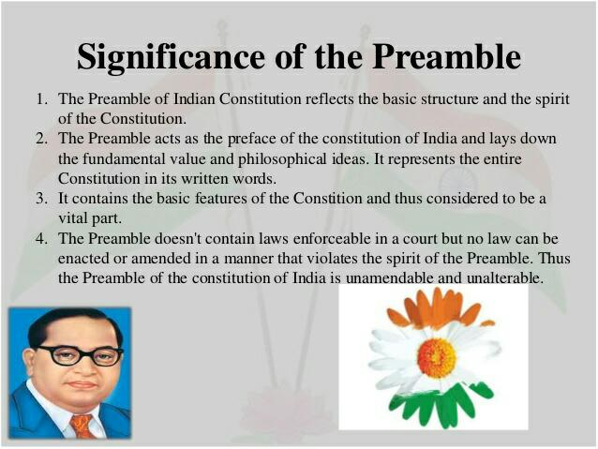

Slide 28
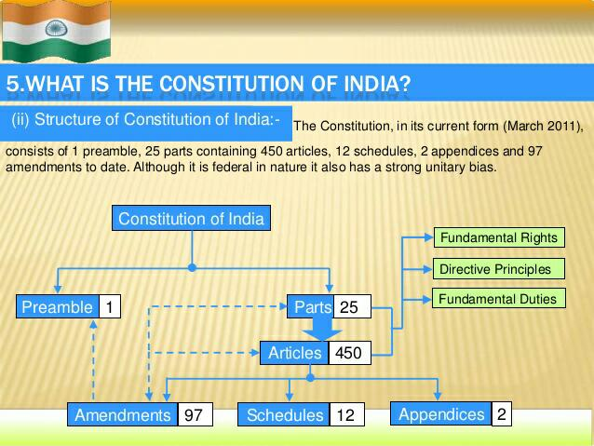

Slide 29
Structure of the Constitution
Different elements of constitution are described as follows:-
1. Preamble (1) - The Preamble to the Constitution of India is a brief introductory statement that sets out the guiding purpose and principles of the document.
2. Parts (25) – The individual Articles of the Constitution are grouped together into the following Parts:
Part I – Union and its Territory
Part II – Citizenship.
Part III – Fundamental Rights.
Part IV – Directive Principles of State Policy.
Part IVA – Fundamental Duties.
Part V – The Union.
Part VI – The States.
Part VII – States in the B part of the First schedule (Repealed).
Part VIII – The Union Territories
Part IX – The Panchayats.

Slide 30
Structure of the Constitution
Part IXA – The Municipalities. (Part IXB – The Cooperative Societies -not effective yet)
Part X – The scheduled and Tribal Areas
Part XI – Relations between the Union and the States.
Part XII – Finance, Property, Contracts and Suits
Part XIII – Trade and Commerce within the territory of India
Part XIV – Services Under the Union, the States.
Part XIVA – Tribunals.
Part XV – Elections
Part XVI – Special Provisions Relating to certain Classes.
Part XVII – Languages
Part XVIII – Emergency Provisions
Part XIX – Miscellaneous
Part XX – Amendment of the Constitution
Part XXI – Temporary, Transitional and Special Provisions
Part XXII – Short title, date of commencement, Authoritative text in Hindi and Repeals
3. Article (1-450) - It is subcategory of different Parts in the constitution which contains detail information of the subject or the Title which an Article represents.

Slide 31
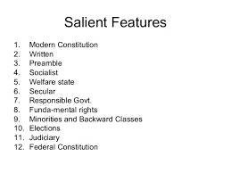

Slide 32
Features of the Indian Constitution
Federal Features-
1. Supremacy of the Constitution,
2. Division of power between the Union (central Governments) and State, and
3. The existence of an independent judiciary in the Indian Constitution.
Unitary Features-
1. Single Citizenship
2. Single Constitution
3. Power of union to override on the state matters
4. During emergency the system became virtually unitary
5. Changes in the names and boundaries of the states by the Parliament
6. Integrated Judiciary System
7. Centre appoints the Governors
8. Dependence of states on the centre for economic assistance and grants.

Slide 33
Main Characteristics of Constitution of India.
The Constitution of India has some distinct and unique features as compared to other constitutions to the world. As Dr. B.R. Ambedkar, the Chairman of the Drafting Committee puts it, the framers had tried to accumulate and accommodate the best features of other constitutions, keeping in view the peculiar problems and needs of our country. Main Characteristics of Constitution of India are:-
Longest written constitution.
Partly Rigid and Partly Flexible
A Democratic Republic
Parliamentary System of Government
A Federation
Fundamental Rights
Directive Principles of State Policy
Fundamental Duties
Secular State
An Independent Judiciary
Single Citizenship

Slide 34
Basic Principles
A careful study of the Constitution will show that there are at least eight basic principles which are embodied in it and which form the foundation of the political system in India. These are:
(1) Popular sovereignty,
(2) Socialism,
(3) Secularism,
(4) Fundamental rights,
(5) Directive Principles of State Policy,
(6) Judicial independence,
(7) Federalism and
(8) Cabinet government.

Slide 35
